Slide 1
ECTS in European higher education: the impact of Bologna
Brussels, 25 February 2013
David Crosier, EURYDICE

Slide 2
Presentation Overview
Comparison of European mapping of ECTS implementation in Bologna official and stakeholder reports:
- Bologna Implementation Report 2012
- EUA Trends 2010
- ESU Bologna with Student Eyes 2012
Common conclusions

Slide 3

Bologna Implementation Report
Programmes using ECTS for accumulation and transfer, 2010/11
< 50%
51 – 74%
75 – 99%
100%
Data not available

Slide 4
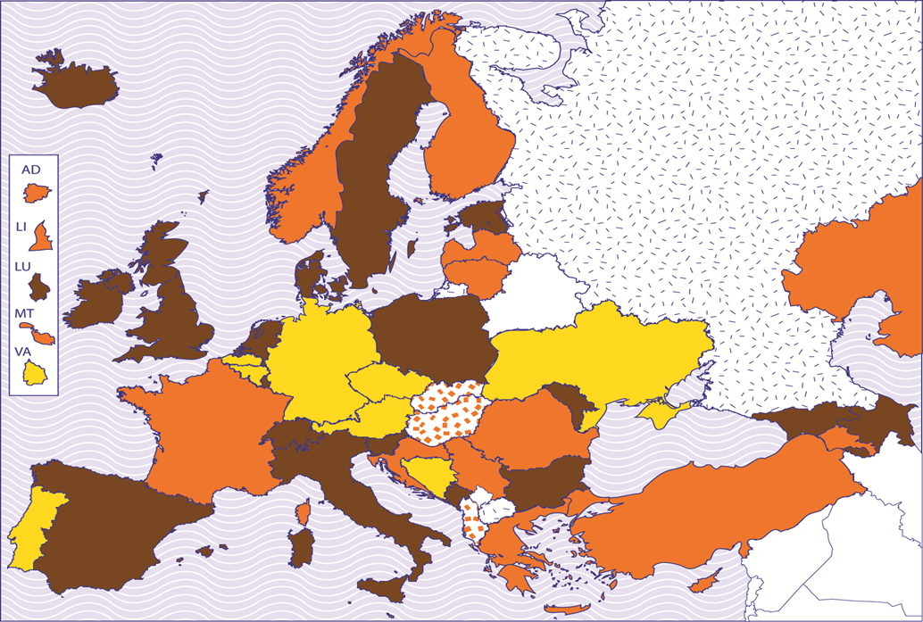
Bologna Implementation Report
ECTS linked to Learning Outcomes, 2010/11
No programmes
< 5%
5 – 49%
50 – 99%
100%
Data not available

Slide 5
Bologna Implementation Report
Scorecard indicator: implementation of ECTS system, 2010/11
ECTS for all programmes; transfer/accumulation & LOs
ECTS for more than 75% of programmes
ECTS for 50 – 75%
of programmes
ECTS for 49% of
programmes or national credit system not fully compatible
ECTS in less than 49% of
programmes or only used for credit transfer
Data not available

Slide 6
EUA Trends 2010
Key Findings
use of ECTS continues to grow:
88% of HEIs using ECTS for credit accumulation in all 1st and 2nd cycle programmes (up from 66% in Trends V)
90% of HEIs using ECTS for credit transfer (up from 75% in Trends V)
Doubts over the way in which ECTS is used

Slide 7
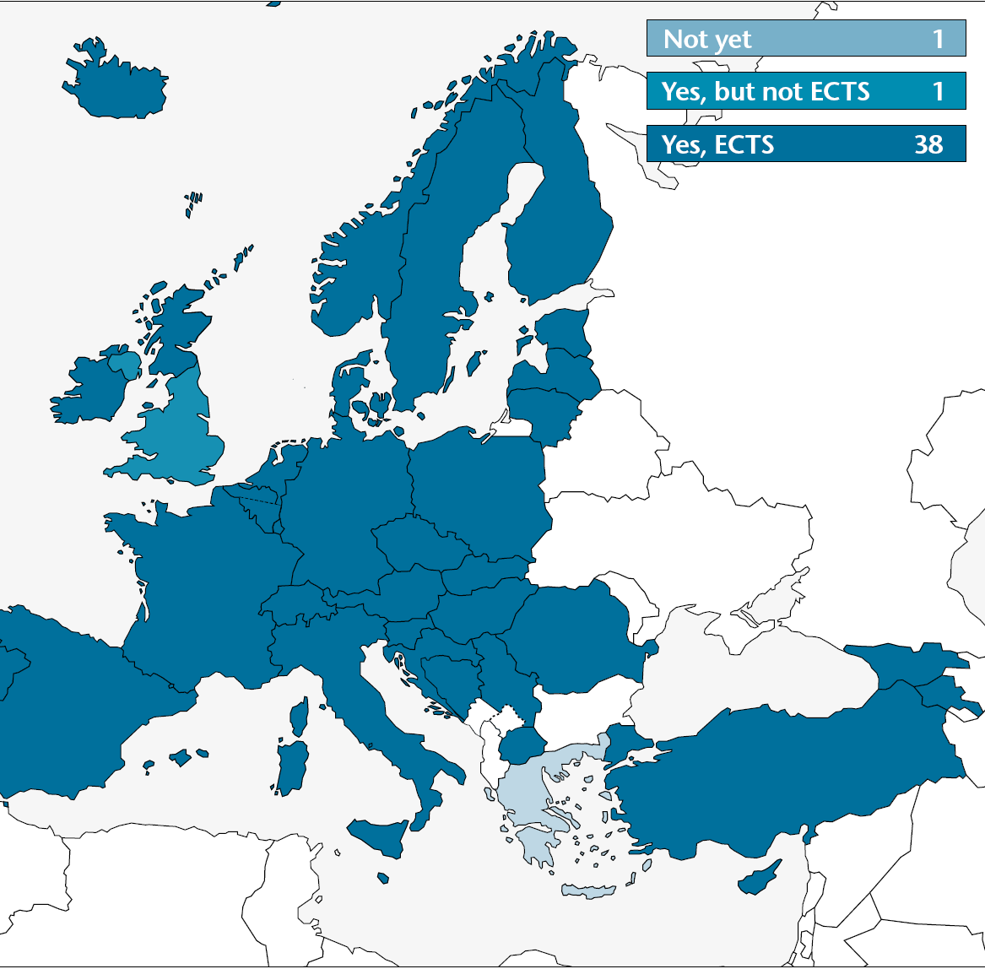
EUA Trends 2010:
Credit transfer by largest group of respondents

Slide 8
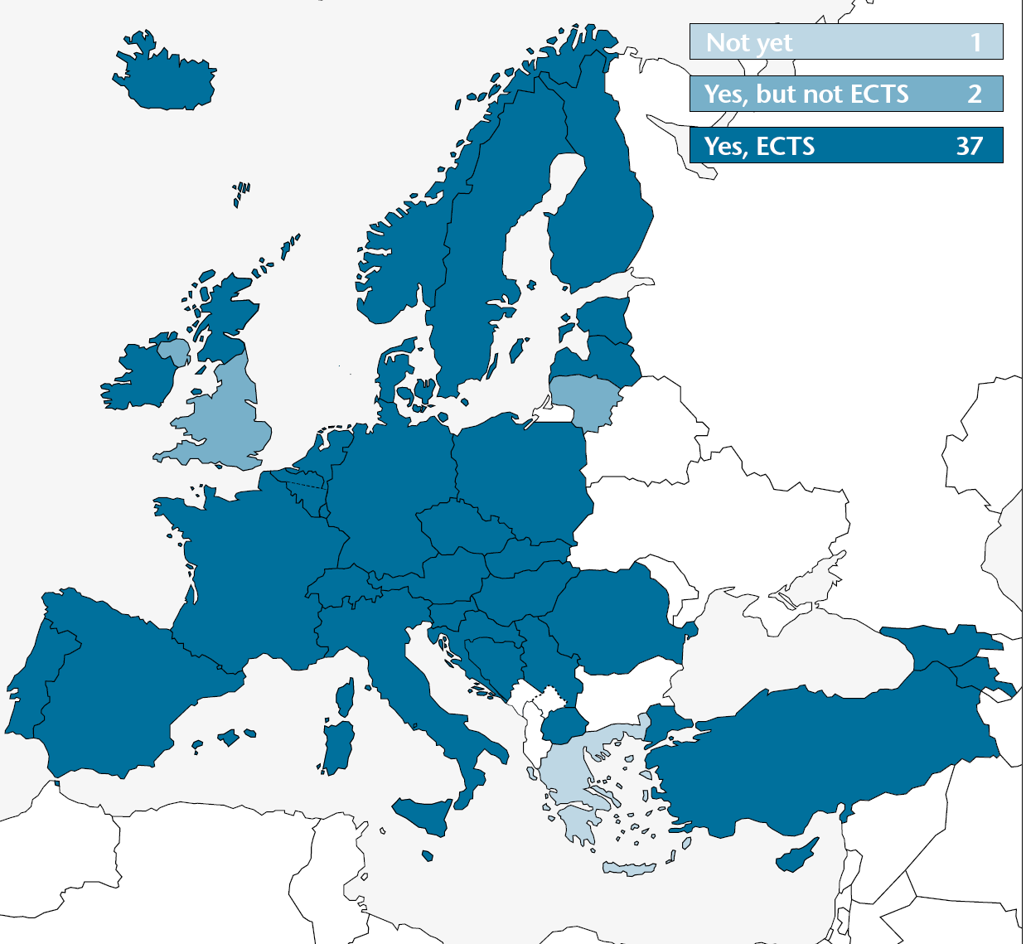
EUA Trends 2010:
Credit accumulation by largest group of respondents

Slide 9
BWSE 2012
Key Findings
Use of ECTS high, but some exceptions:
while 24 (of 31) student unions report widespread use of ECTS, 5 say that use is low/non existent
in 21 systems workload commonly used as a basis for credits
In 12 systems, learning outcomes are used

Slide 10
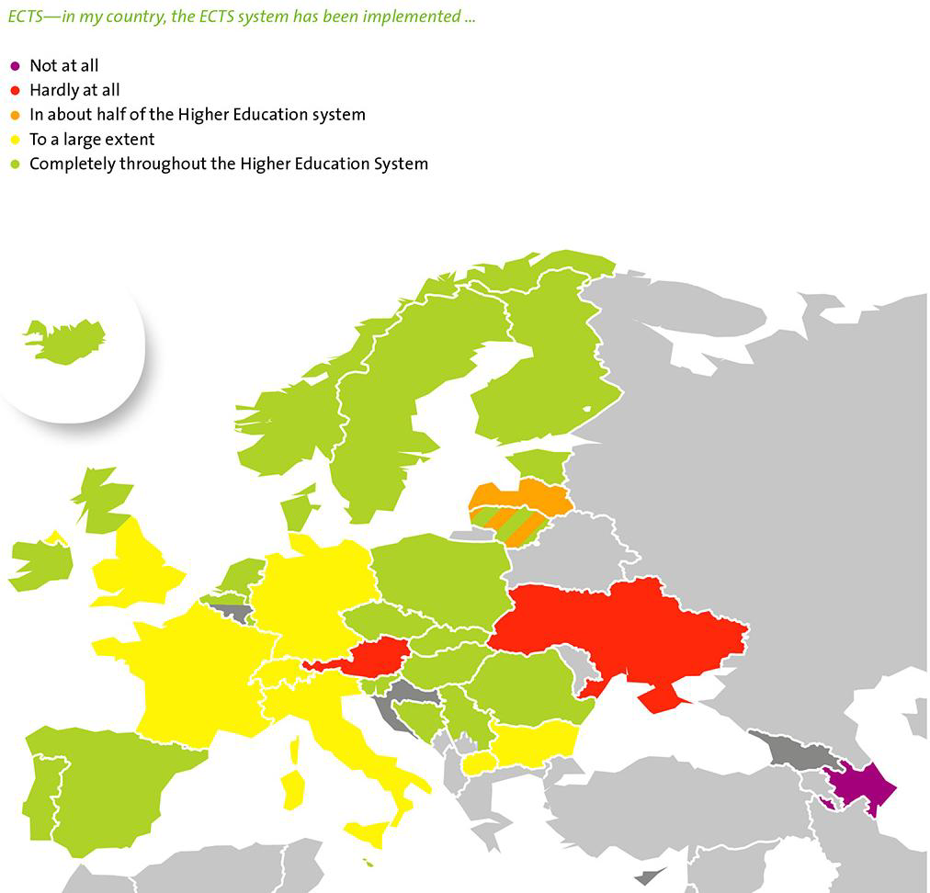
ESU BWSE 2012

Slide 11
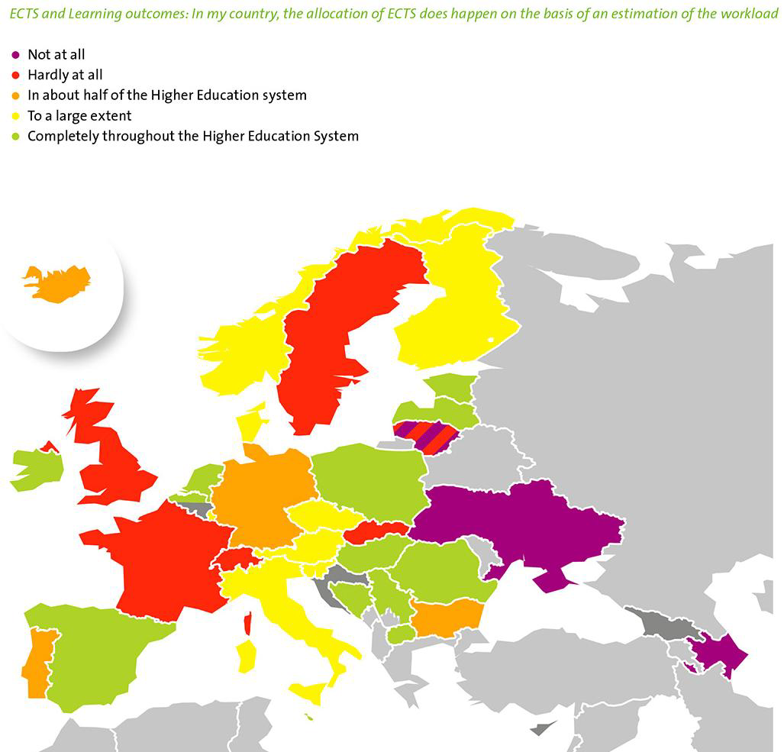
ESU BWSE 2012

Slide 12
Common conclusions from the reports:
Use of ECTS has developed to a point where it is unchallenged as the credit system for higher education
The intended purposes of the system are not fully addressed in national/institutional implementation
Learning Outcomes are not yet widely understood & used in programme design, & hence the "ideal approach" of the 2009 User Guide is rarely found in reality

