Slide 1

Engineering Education and Bologna-Process at TUB
Dr. Patrick Thurian, Head of Quality Management, Strategic Controlling
Technische Universität Berlin | 24nd Januar 2017

Slide 2
Content
Profile of the TU Berlin
The Bologna-Process
Engineering Education and Bologna-Process at TU Berlin
  Master Human Factors
  Joint Master Program: Innovation Management and Entrepreneurship
Quality Management
Summary

Slide 3
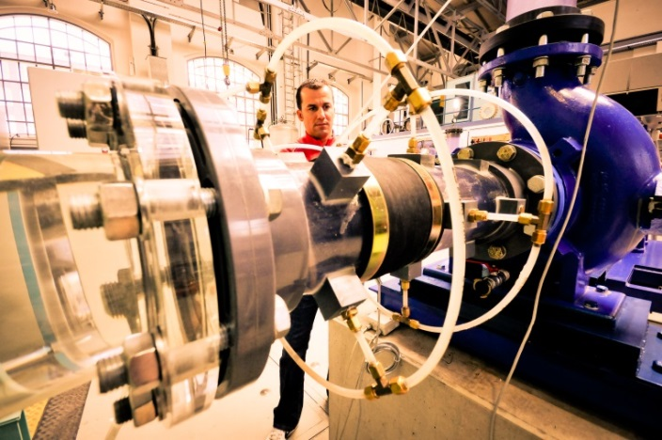
Profile of TUB - University with Entrepreneurial Tradition
Technology focused location: 34,400 students,
331 professors and 2,691 research scientists in the
heart of the city of Berlin
more than 30 year history of technology transfer
first high-tech incubator in Germany
800 technology-oriented spin-offs and founders
founders survey 2016: 2.6 billion turnover, 18,400 employees
awarded status as “Die Gründerhochschule” by federal ministry of Economics and Energy (BMWi)

Slide 4
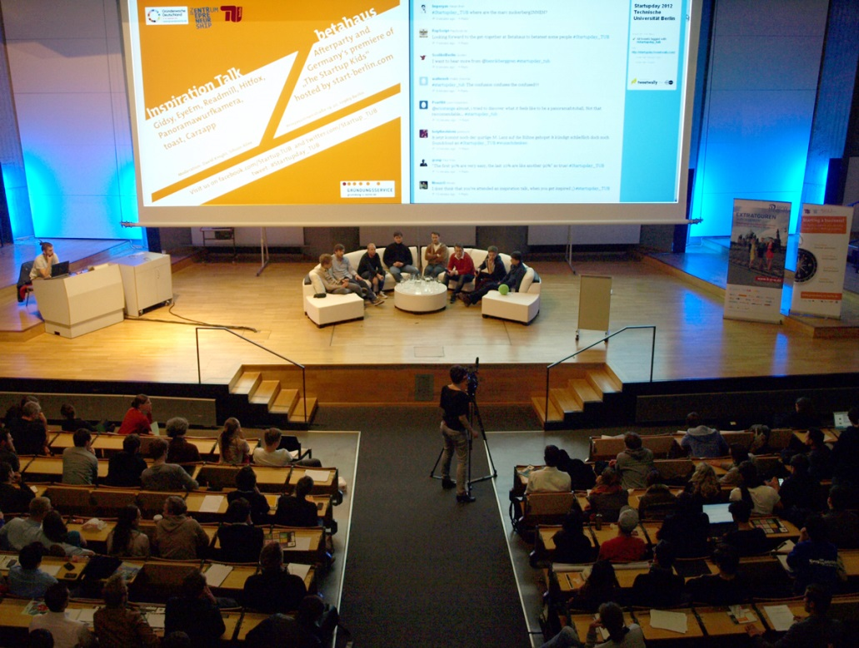
Inspiration: Start-up Day
Role models on stage
  International Entrepreneurs
  (eg. Niklas Zennström, Skype)
  Real Start-ups from our networks:
  „Berlin All Stars“ and TU teams
  Audience: 500-1,000 people
  Get together and „speed dating“
  Involvement of student-club
Notes:
„Inspiration Talk“ at TU Audimax.

Slide 5
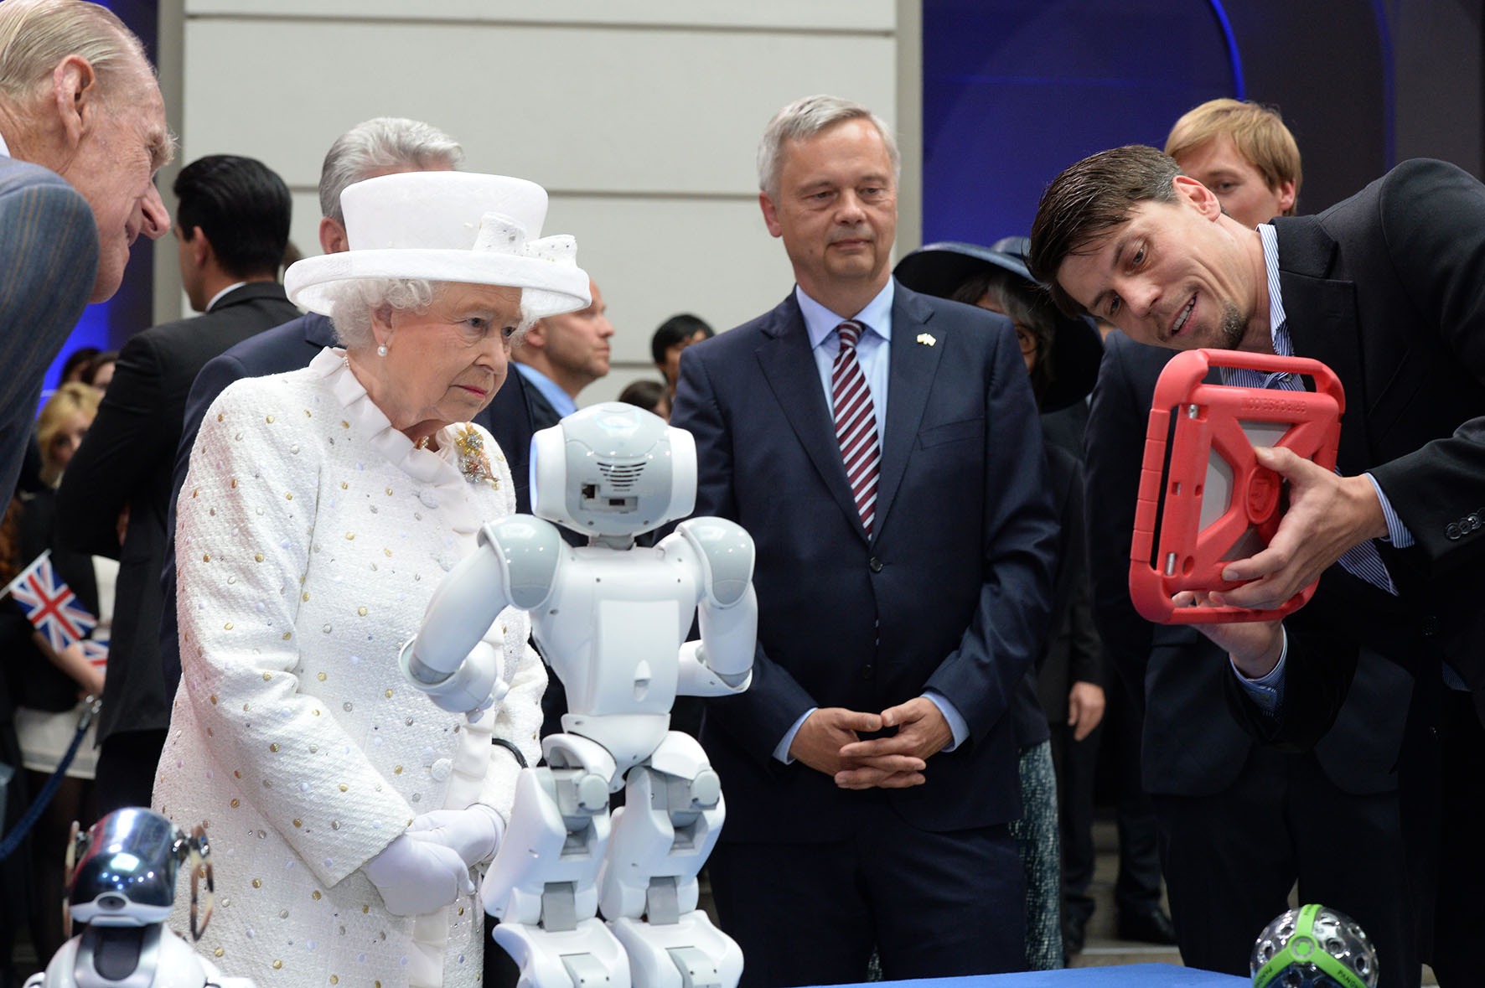
Notes:
TU Start-up Panono – the panoramic ball camera. Capture more than just a picture with the Panono Camera and discover a whole new experience.
Founder Jonas Pfeil created the prototype for Panono as part of his master’s thesis in computer engineering at the Technical University of Berlin. In 2012, he and his co-founders formed Panono GmbH to bring the camera ball to market.

Slide 6
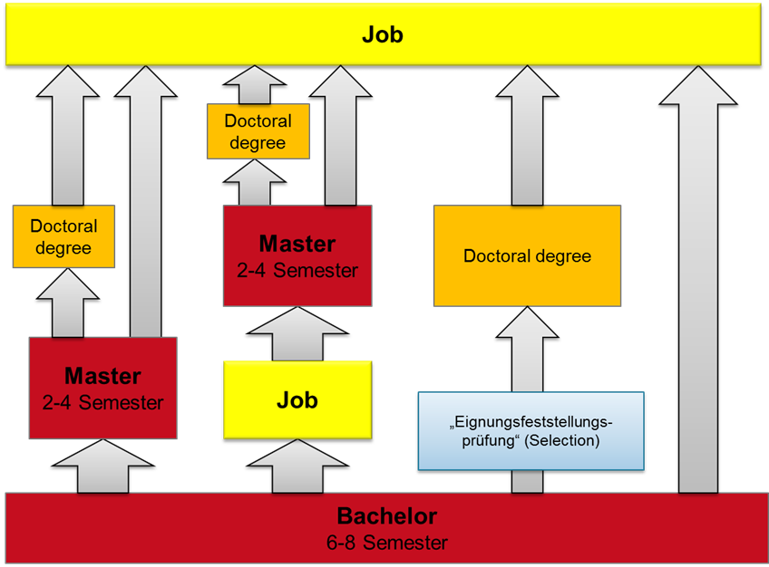
The Bologna-Process

Slide 7
The Bologna-Process at TUB
The TUB offers 120 study-programs (99 % are Bachelor and Master programs (winterterm 2016/2017))
The Bachelor and Master programs have to be accreditated in Berlin
78 programs successfully passed program-accreditation
TUB accomplishs system-accreditation
The profile of the Bachelor and Master programs is given by the research profile

Slide 8
Requirements for modern education in engineering
Characteristics of an excellent engineer
Technical knowledge/expertise
Learning, developing and improving
Flexibility in adapting to change
Management/motivation of people
Management of projects/events
Team-working; multidisciplinary/cultural
Communication, verbal and written
Focus on business/clients
Proving leadership and vision
Commitment to ethical and social responsibilities
Commercial/financial knowledge/expertise

Slide 9
Engineering Education and the Bologna-Process
European Credit Transfer System and 2-cycle
2 cycle = 3+2 years
Master is the goal
30 ECTS/Semester
→ B/M in total: 300 ECTS
→ Bachelor = 180 ECTS
→ Master = 120 ECTS
1 ECTS / 30 h workload
ECTS: European Credit Transfer System

Slide 10
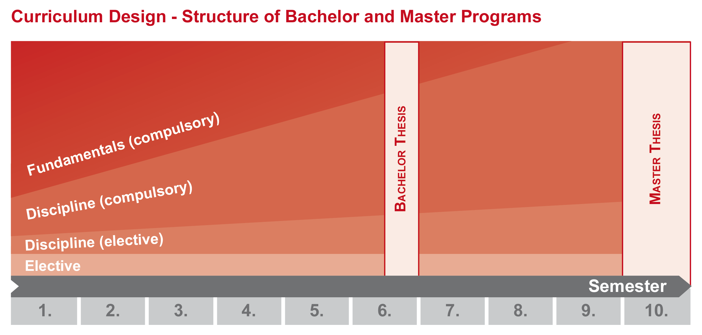
Engineering Education and the Bologna-Process
Curriculum design - Structure of Bachelor and Master Programs

Slide 11
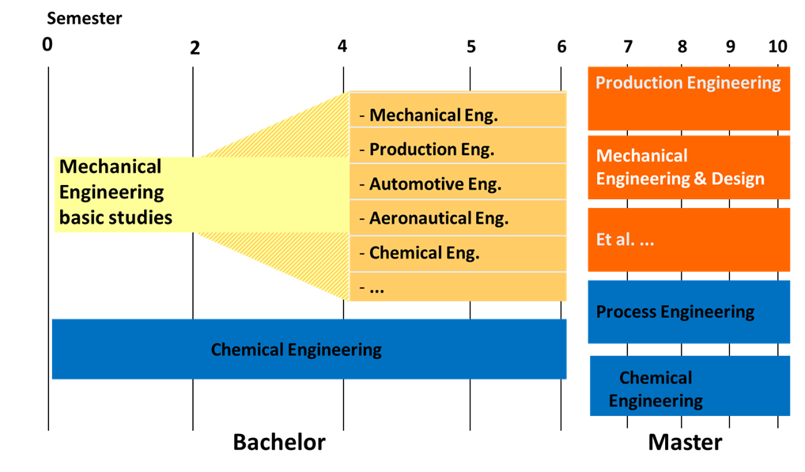
Engineering Education and the Bologna-Process
Curriculum design – Structure of Bachelor and Master Programs

Slide 12

Engineering Education and the Bologna-Process
Curriculum design – Example 1: Master Human Factors
Profile:
Interdisciplinary program between psychology and engineering
Understanding and optimization of the interaction
between man and machines
Targetgroup: Psycholog./Engineers
Duration: 4 Semester
Students: 40 (winter) / 10 (summer)

Slide 13
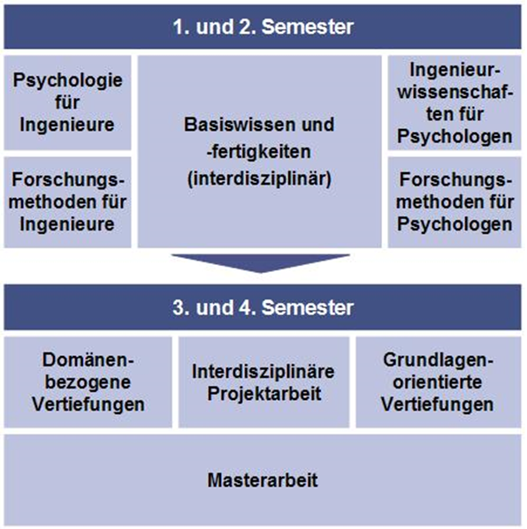
Engineering Education and the Bologna-Process
Curriculum design – Master Human Factors

Slide 14
Engineering Education and the Bologna-Process
Curriculum design – Structure of Bachelor and Master Programs
  Entrepreneurship education is integrated in the compulsory or in the compulsory/-elective part of the TUB curricula and in Summer Schools as well.
  Modules are:
  Venture Campus (6 ECTS)
  Entrepreneurship Research (6 ECTS)
  Entrepreneurship – FÜS (6 ECTS)

Slide 15


Example 2: Joint Master Program: Innovation Management and Entrepreneurship (IME)
Curriculum design – 2-year Master
  Compulsory (24 ECTS):
  Entrepreneurship Research (6 ECTS)
  Business Research Methodes (6 ECTS)
  Venture Campus (6 ECTS)
  Innovation Economics (6 ECTS)
  Compulsory Elective (36 ECTS)
  Elective (30 ECTS)-Students stay abroad
  Thesis (30 ECTS)

Slide 16
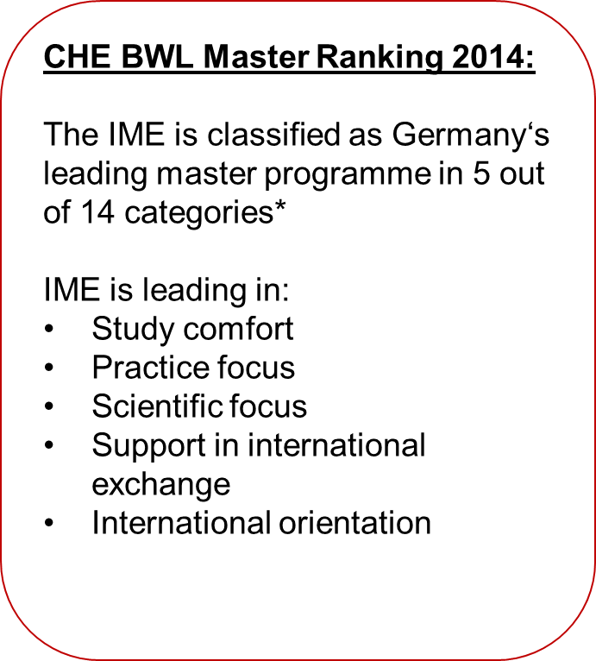
Example 2: Joint Master Program: Innovation Management and Entrepreneurship (IME)

Slide 17
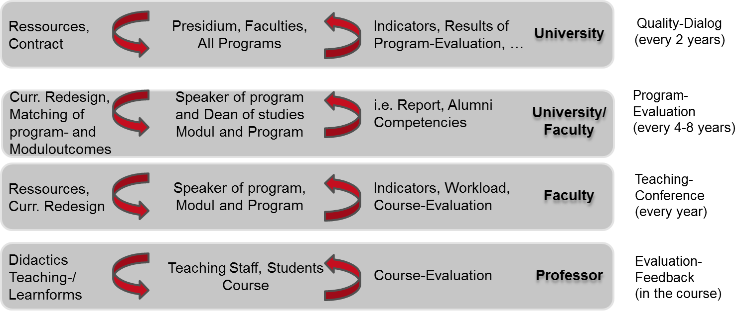
Loops of the Quality Management System

Slide 18
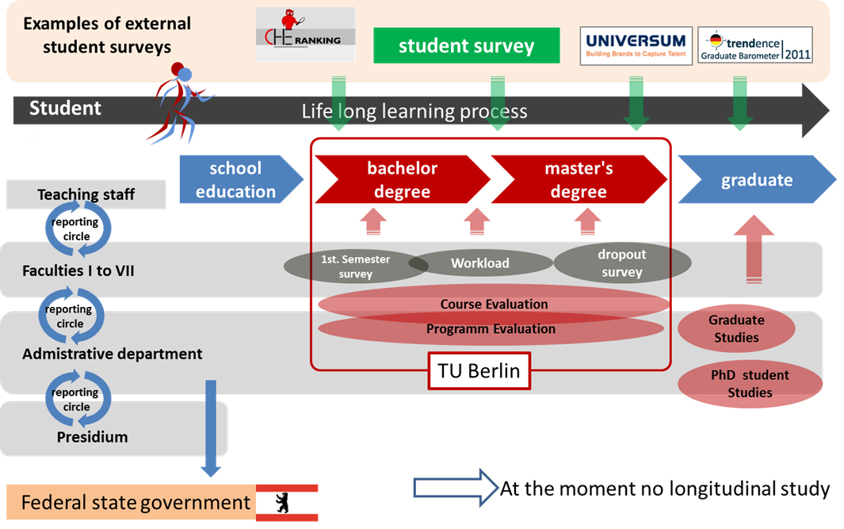
Quality Management – Instruments and Results

Slide 19
Quality Management – Results of Graduate Studies
Keyfacts of the graduation cohort 2013 – part I
 | Bachelor | Master | Diplom | TUB overall average
Percentage of female gender | 35 | 30 | 28 | 33
Grade average (Abitur) | 2,1 | 2,1 | 2,4 | 2,2
Average age at time of graduation | 25,3 | 28,3 | 29,5 | 27,3
Grade average of graduation | 2,2 | 1,6 | 1,7 | 1,9
Average duration of study | 8,0 | 5,0 | 14,0 | 8,0
N | 519 | 309 | 261 | 1.128

Slide 20

Quality Management – Results of Graduate Studies
Keyfacts of the graduation cohort 2013 – part II
 | Bachelor | Master | Diplom | TUB overall average
Average duration for job search (in month; Median) | 1,0 | 2,0 | 3,0 | 2,0
Average income (pre-tax) per month after graduation (Median; Only full-time employee) | 2.750 € | 3.250 € | 3.250 € | 3.250 €
Overall satisfaction with course of studies at TU Berlin (Median 1=very satisfied / 5=very unsatisfied) | 2,0 | 2,0 | 2,0 | 2,0
Overall job satisfaction (Median 1=very satisfied / 5=very unsatisfied) | 2,0 | 2,0 | 2,0 | 2,0
N | 519 | 309 | 261 | 1.128

Slide 21
Quality Management – Results of Graduate Studies
Students who stay in Berlin after graduation

Slide 22
Quality Management – Results of Graduate Studies
Income after graduation

Slide 23
Quality Management – Results of Graduate Studies
Graduates as entrepreneurs

Slide 24
Summary
The transition from Diploma to Bachelor – and Master structure has been successfully completed. However, Bologna 2.0 is right ahead and more improvement is needed!
Quality management was established successfully.
There is no simple way from „check“ to „act“!
Communication is essential in the change management process!

Slide 25
Contact:
patrick.thurian@tu-berlin.de

