Slide 1
Ministry of Education
University of Montenegro
BFUG BOARD MEETING
Chisinau, 18 January 2016

Slide 2

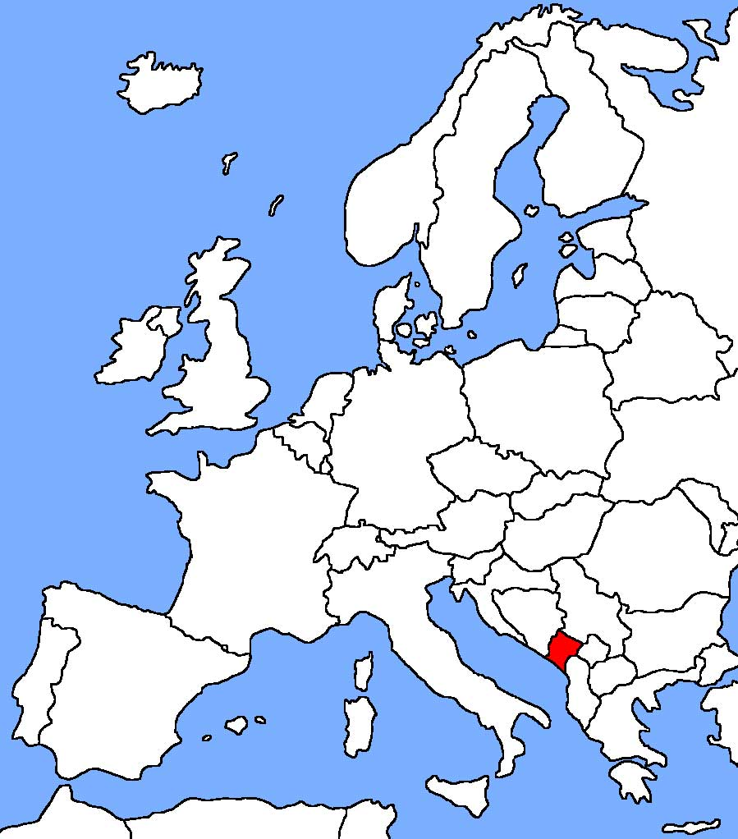
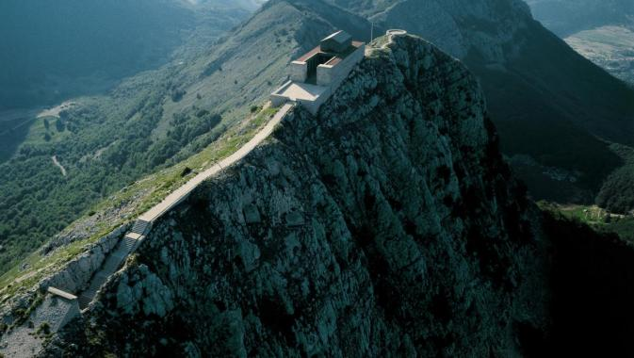
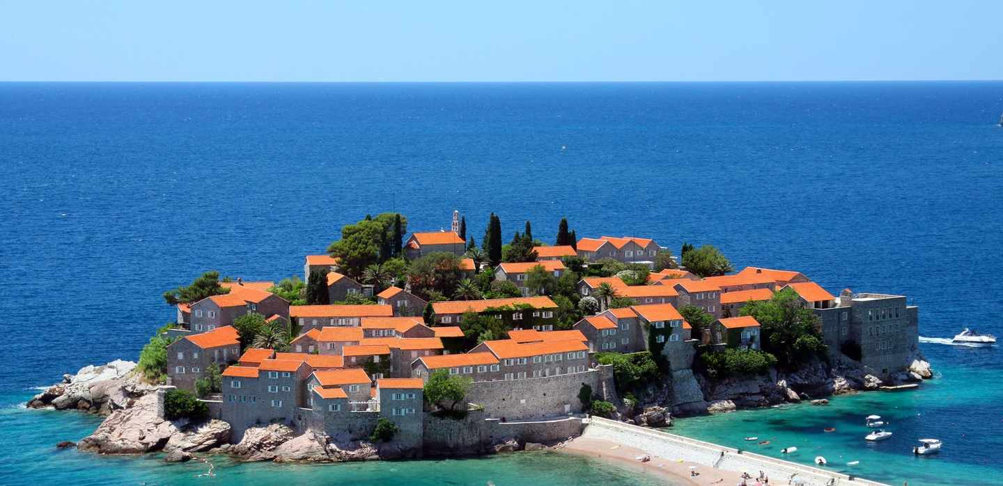
Montenegro
Montenegro (Montenegrin: Crna Gora), is located in South-Eastern Europe
Capital city – Podgorica
Total area – 13,812 km2
Population – 620,029 inhabitants

Slide 3
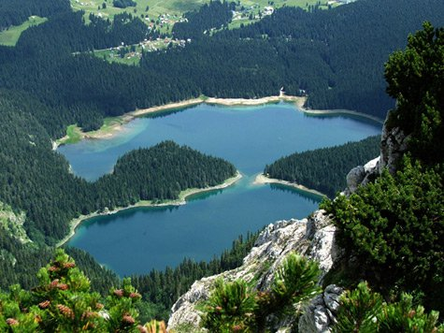
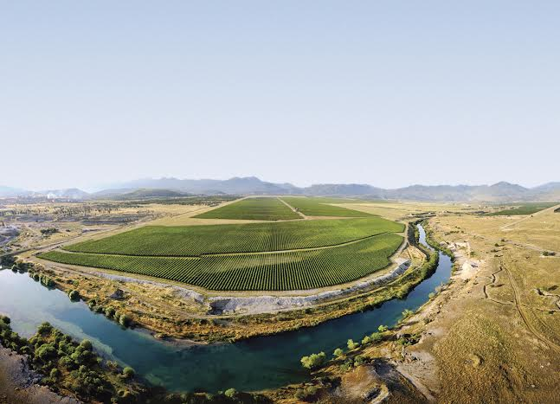
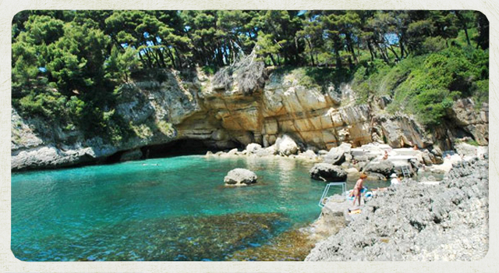
Economy
Agricultural processing
Aluminium
Tourism

Slide 4
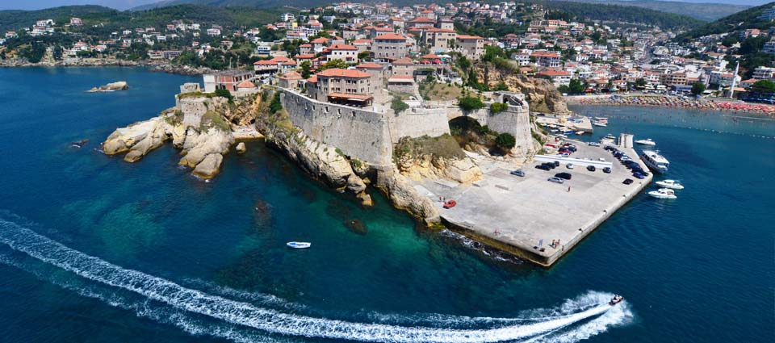


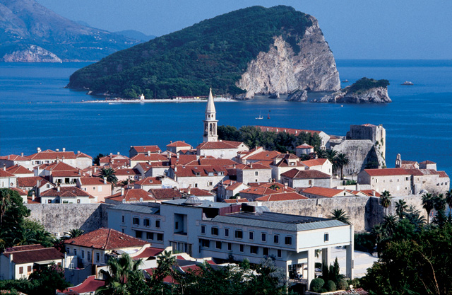
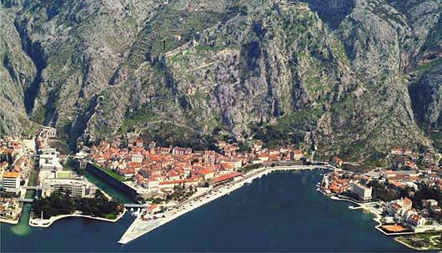
Montenegro

Slide 5
Montenegrin educational system
Montenegrin educational system includes preschool education, primary education, secondary general education (gymnasium), vocational education, upbringing and education of persons with special needs, upper secondary non tertiary education, adult education and tertiary education.
The Ministry of Education is responsible for the entire field of education.
Budgetary allocations for education is 4,2% of GDP
Total budget of the Ministry of Education, in accordance with the Law on Budget 2016, is 142.775.860,41 mil€
Total budget of the University of Montenegro, in accordance with the Law on Budget 2016, is 16.857.228,10 mil€

Slide 6
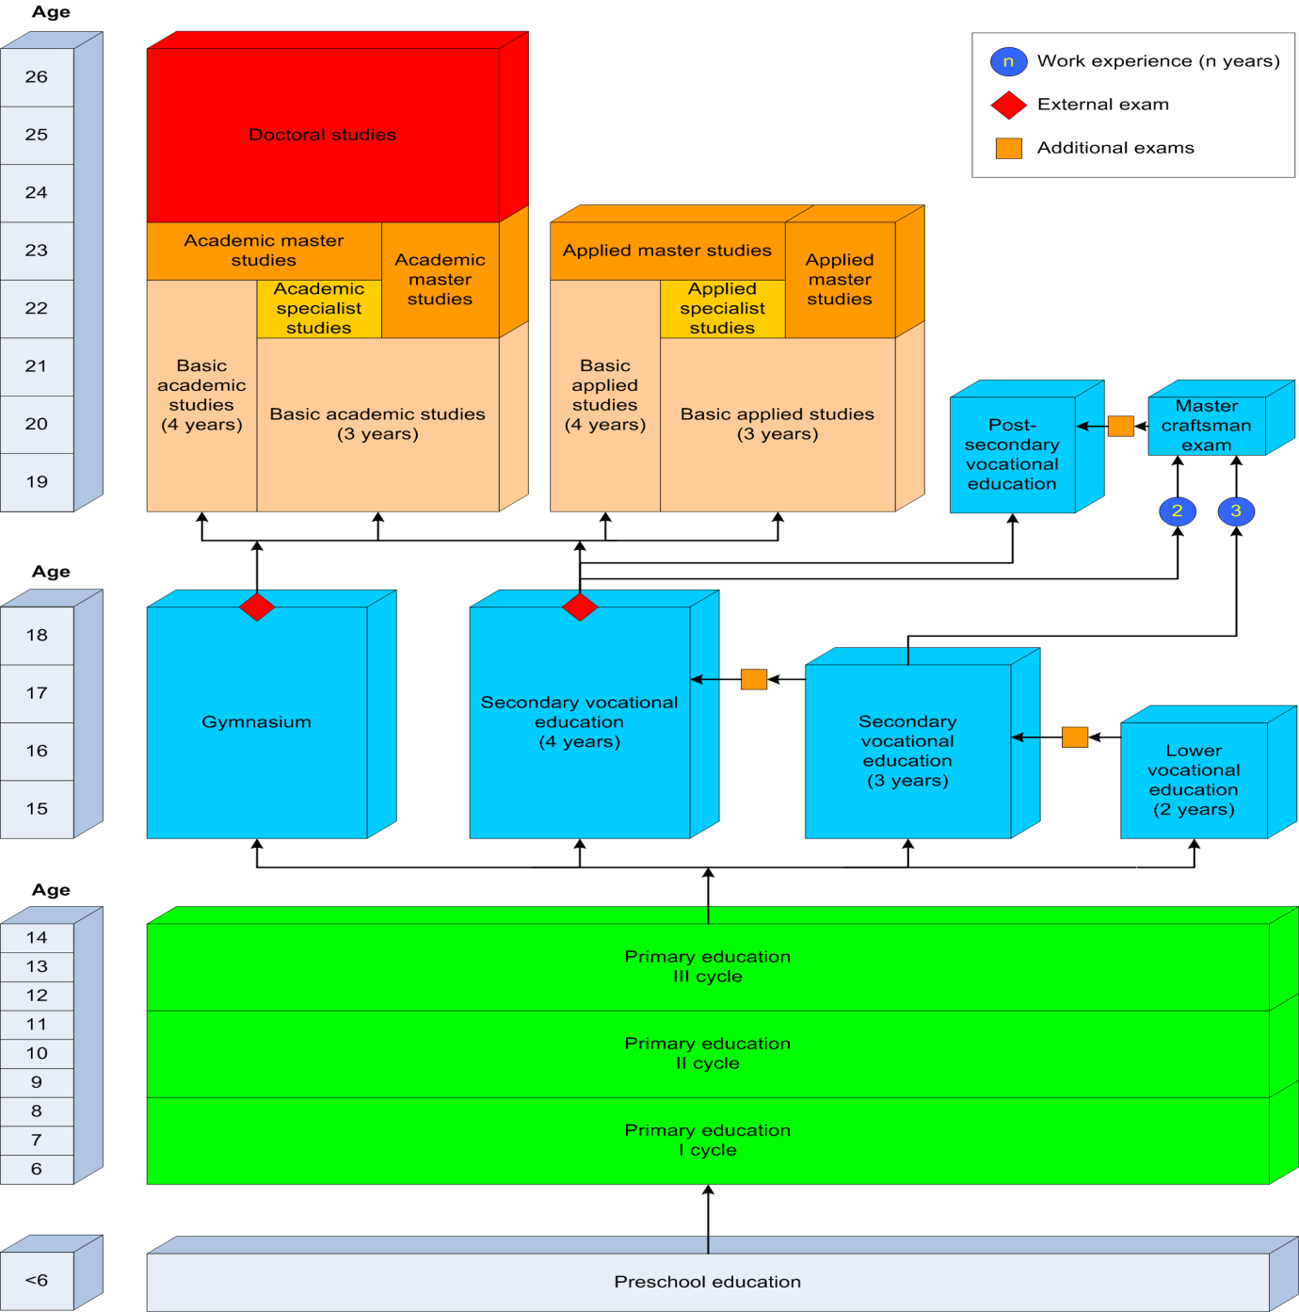

Slide 7
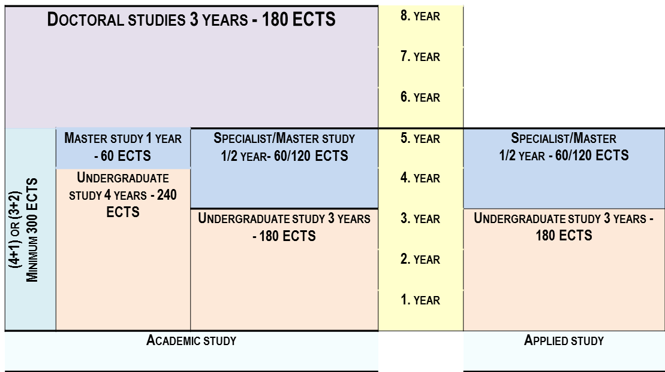
Higher education structure

Slide 8
Higher Education
Higher education is being implemented by universities and other institutions of higher education

Slide 9
Legislation
Law on Higher Education
Law on Recognition of Foreign Credentials and Equivalence of Qualifications
Law on National Qualifications Framework
Enrolment Policy at the University of Montenegro
Law on Professional Training for Persons with acquired Higher Education
Decree on Norms and Standards for Financing of public HEIs and Financing of Students at HEIs
Strategy on Development and Financing of Higher Education 2011-2020
Rulebook on procedures of qualification development from sixth to eight qualification levels

Slide 10
Census of Population, Households and Dwellings in Montenegro 2011

Slide 11
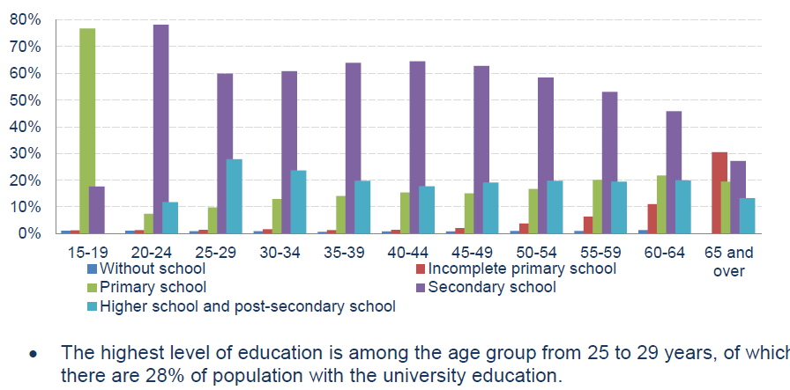
Census of Population, Households and Dwellings in Montenegro 2011

Slide 12
current situation
The Law on Higher Education was adopted by the Parliament in 2003
Changes and amendments done in 2010, 2011
New Law was adopted in October 2014
Rapid growth of HE sector after 2003
Change of the number of HEIs from only one public university in 2003 to two private universities, 9 individual private faculties and one individual public faculty in 2015

Slide 13
Current situation
Higher education may be provided by the universities and higher education institutions, which are licensed and accredited in accordance with the Law
According to this Law, higher education is an activity of public interest which provides obtaining a degree of:
applied undergraduate studies
academic undergraduate studies
applied specialist studies
academic specialist studies
applied master studies
academic master studies and
academic title of a PhD.

Slide 14
The current situation with regards to the financing & access to HE in Montenegro
75 % of students pay tuition fee at public university, self-financed
25% of students at public university are budget financed
98 % of students at private HEIs pay tuition fee
Tuition fee at public university is 500€/year mostly, at some study programs is 1.000€/year
Tuition fee at private HEIs is from 1.200-1.600€/year
Average cost per budget financed student at UoM is 3.631€

Slide 15
The current situation with regards to the financing & access to HE in Montenegro
In accordance with Law it is possible to allocate funds from the budget of Montenegro to students of private institutions attending study programmes of public interest that are not implemented at any public institution
Criteria for determining the study programmes of public interest at private institutions that are not implemented at any public institution are prescribed by the Government, following the opinion provided by the Council For Higher Education.

Slide 16
FUNDING
An institution may be financed from the following sources:
founder’s assets;
tuition fees and other fees paid by the students;
intellectual and other services;
donations, presents and legacies;
income from property (lease);
projects and contracts with international, national and private entities aimed at promotion of teaching, research and consulting activities; and
other sources in compliance with law.

Slide 17
Admission into a Study Programme
Students are admitted at a competitive basis, all in compliance with the results obtained during secondary school education, at the professional or matriculation exam and the results obtained at the additional or admission exam
For enrolment to certain study programmes, an admission exam may be introduced
The matriculation, or professional exam is valued with at least 15% of the total number of points obtained at admission
More detailed conditions and criteria, method and procedure of enrolment to first year of undergraduate academic and applied studies is prescribed by the Ministry, following the prior opinion of the Council.
For persons with disabilities the principle of affirmative action is conducted on the occasion of enrolment to a study programme. A student with a disability is entitled to take an exam in a manner adjusted to their educational needs in compliance with statute of an institution.
A foreigner is entitled to be enrolled into study programmes in Montenegro, under the same conditions as Montenegrin citizens, in compliance with this Law and statute of an institution.

Slide 18
Rights Pertaining to Student Standard
A student is entitled to:
dormitory room and board;
students loan;
scholarships for best students;
transport allowance concerning suburban and intercity traffic;
health care in compliance with special law;
establish sport associations in accordance with law.
The criteria, manner, conditions and the amount of fee for exercising are prescribed by the Ministry.

Slide 19
Number of students taking student loans, scholarship for talented students, students’ hostel accommodation
13.66% of Montenegrin students are using students` loans
Till 2011/2012 year, only budget students were entitled to apply for scholarships and loans
From 2011/2012 year onwards, rights ensuring from students standards can use all students that fulfill prescribed conditions
Scholarships are given to „the best students“, students with highest marks and special affinity towards scientific/artistic work, and who were rewarded prizes at state and international competitions. Total number of this category of students is 300.
Accommodation in students’ hostel is provided for 1.897 students

Slide 20
World Bank Loan
Aim of the HERIC project (Higher Education and Research for Innovation and Competitiveness Project) financed by WB loan is to strengthen the quality and relevance of higher education and research in Montenegro through reforming the higher education finance and quality assurance systems and by strengthening research and development capabilities.
Component 1 – Higher Education Finance Reforms and Implementation of Quality Assurance Norms
Component 2 – Human Capital Development through Internationalization Initiatives
Component 3 – Establishing a Competitive Research Environment
Component 4 – Project Management and Monitoring and Evaluation
Total budget is 12 million €

Slide 21
Professional Training for Persons with acquired Higher Education
Law adopted in July 2012
Professional training is dedicated to the persons holding higher education degree without working experience in concrete educational level and recorded at the Employment Bureau evidence;
Professional training is in duration of 9 months recognized as 12 months of working experience enabling individuals to pass professional exam
Relevant partners: employers (public, private), higher education institutions, graduates
The goal of this Programme is to provide support to university graduates in order to obtain adequate practical knowledge

Slide 22
Assessment of the needs for various educational levels

Slide 23
Challenges
Greater Harmonization of the Education System with the Needs of the Labor Market
Increasing Participation in Lifelong Learning
Establishing a System of Monitoring (tracer study) of the Persons After Completion of Educational, or Study Programme
Continuous Improvement of the Quality of Education at all levels
Introduction of Practical Training in Educational Programs
Increasing Interest in Deficit Occupations Education
Development of the social dimension of higher education, provide adequate student support services, counseling and guidance, flexible learning paths and alternative access routes, including recognition of prior learning
Equal Access to Education Opportunities for Marginalized Groups

Slide 24
CHALLENGES
Strengthening the capacities of educational institutions to use the EU ERASMUS+ programmes through training programmes and cooperation with Erasmus+ office.
Improvement of accommodation infrastructure
Innovation of curricula
Ensure that qualifications frameworks, ECTS and Diploma Supplement implementation is based on learning outcomes

Slide 25
Thank you for your attention
www.mps.gov.me
www.ucg.ac.me

